Slide 1
A Project Report on Mother Dairy
DIGITAL MARKETING INTERNSHIP
MENTOR:
K.RATNA KUMARI MADAM
PRESENTED BY
MUKKU.HEMA JYOTHI
Reg No:213888200057
ADIKAVI NANNAYA UNIVERSITY
SRI VASAVI DEGREE COLLEGE(TADEPALLIGUDEM)

Slide 2
Comprehensive Digital Markerting For Mother Dairy SMART BRIDGE ORGANIZATON SRI VASAVI DEGREE COLLEGE(TADEPALLIGUDEM) TEAM DETAILS
1.Team Leader : Mukku Hema Jyothi
2.Team Member : Kamisetti Ramya Sri
3.Team Member : Teeparthi Lalitha Sri
4.Team Member : Tummidi Satya Devi Durga
5.Team Member : Seesala Sirisha

Slide 3
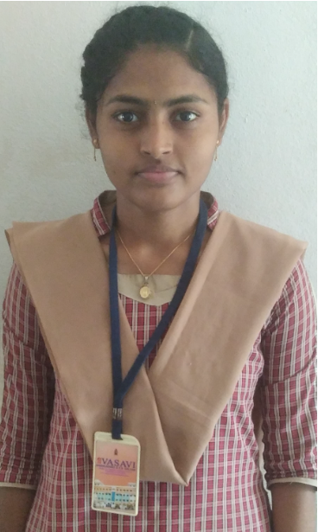




TEAM LEADER
Name : Mukku Hema Jyothi
Email:hemajyothi1214@gmail.com
Ph No : 9346174508
Reg.No:213888200057
TEAM MEMBER
TEAM MEMBER
TEAM MEMBER
TEAM MEMBER
Name : Teeparthi Lalitha Sri
Email:lalithasriteeparthilalithasre@gmail.com
Ph No : 8688161517
Reg.No:213888200079
Name : Tummidi Satya Devi Durga
Email:tummidisatyadevidurga02@gmail.com
Ph No : 8688838792
Reg.No:213888200081
Name : Seesala Sirisha
Email:gangarajuseesala@gmail.com
Ph No : 9392381929
Reg.No:213888200076
Name: Kamisetti Ramya Sri
Email:kamisettikittu@gmail.com
Ph No : 8978262029
Reg.No:213888200036

Slide 4
CONTENTS:
1.Brand Study,Competitor Analysis & Buyer’s/Audience’s Persona:
Research Brand Identity
Competitor Analysis
Buyer’s/Audience’s Persona
2.SEO & Keyword Research:
SEO Audit
Keyword Research
On page Optimization

Slide 5
3.Content Ideas &Marketing Strategies: . Content idea Generation & Stratery . Marketing Strategies
4. Content Creation & Curation:
Post Creation
Designs /Video Ad Campaigns
Social Media Ad Campaigns
Email Ad Campaigns

Slide 6
Brand Study (Mission /Values& USP)
The value of a grand study mission lies in its ability to provide aclear concise purpose for the company. The mission statement shouid also focuse on the target audience.
MISSION VALUE :
MISSION:Sustain market leadership in the production and marketing of a varity of liquid milk and product with asssured quality at an affordable price.
VALUES: Mother dairy is committed to providing high-quality milk and milk products to its customers.

Slide 7
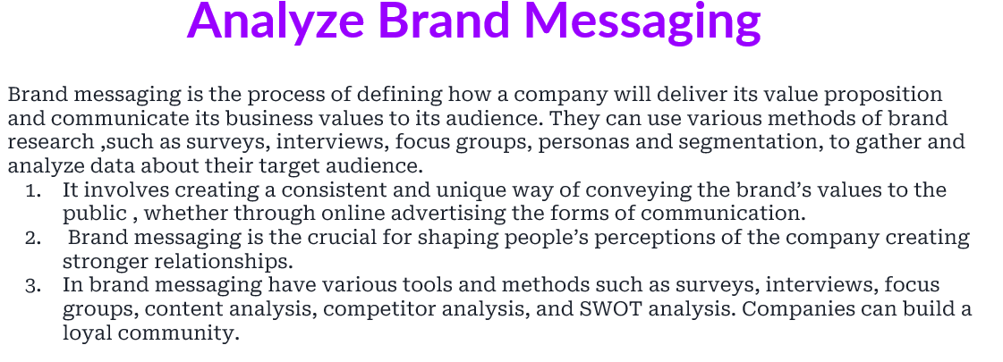

Slide 8
1. COMPEITOR ANALYSIS
When conducting a competitor analysis of Mother Dairy, it's important to consider other major players in the Indian dairy industry. Here are some key competitors:
Competitor-1. Amul:
Amul is one of the biggest competitors of Mother Dairy. It is a cooperative dairy company known for its wide range of dairy products, including milk, butter, cheese, ice cream, and more. Amul has a strong presence across India and is known for its innovative marketing campaigns and competitive pricing.
Strengths: Strong brand presence, extensive distribution network, diverse product portfolio.
- Weaknesses: Regional focus, potential supply chain challenges.
- Opportunities: Expansion into new markets, product innovation.
Threats: Intense competition, changing consumer preferences.

Slide 9
Competitor-2. Nestle:
Nestle is a multinational food and beverage company that competes with Mother Dairy, particularly in segments like milk, yogurt, and dairy-based beverages. Nestle's dairy brands include Nestle Milk, Nestle Dahi (yogurt), and Nestle A+, among others. Nestle focuses on quality and nutrition, leveraging its global reputation and distribution network.
Strengths: Global brand recognition, extensive R&D capabilities, diverse product range.
Weaknesses: Competition from local brands, pricing strategy.
Opportunities: Innovation in health-focused dairy products, market expansion.
Threats: Regulatory changes, consumer perception of processed foods.

Slide 10
Competitor-3. Paras Dairy
Paras Dairy is another significant competitor in the India dairy industry.
It offers a variety of dairy products such as milk,ghee, butter, paneer and yogutry.Paras Dairy emphasizes its commitment to quality and purity, targeting health-conscious consumers.
Strengths:Focus on premium dairy products, strong distribution network.
Weaknesses:Limited brand recognition compared to larger competitor, regional presence.
Opportunities: Market expansion, diversification into new product categories.
Treats: Competition from established brands,supply chain disruption.

Slide 11
Competitor-4.Mother Dairy's own regional competitors:
Strengths: Local brand loyalty, understanding of regional preferences.
Weaknesses: Limited distribution outside their regions, fewer resources for innovation.
Opportunities: Leveraging local ties for market dominance, expansion into adjacet
markets.
Threats: Mother Dairy's expansion efforts, larger competitors entering local markets.
Analyzing these competitors' strengths, weaknesses, opportunities, and threats can provide insights into how Mother Dairy can position itself strategically in the market.

Slide 12
1.3 BUYER’S/AUDIENCE’S PERSONA
The buyer personas or audience profiles for Mother Dairy typically include:
1.Health-Conscious Consumers:
These individuals prioritize health and nutrition in their food choices. They are interested in dairy products that are natural, fresh, and free from additives. They may also be concerned about the sourcing and production methods of dairy products, preferring brands like Mother Dairy that emphasize quality and purity.
2. Family-oriented Shoppers:
Family-oriented buyers are often the primary purchasers of dairy products like milk, yogurt, and cheese. They look for products that are safe for consumption by all family members, including children and elderly members. They value brands like Mother Dairy that offer a wide range of dairy options suitable for different family members' preferences and dietary needs.

Slide 13
4. Price-Conscious Consumers:
Price-conscious buyers are concerned about getting value for their money. While they prioritize affordability, they also expect decent quality and freshness in dairy products. Mother Dairy's competitive pricing strategy makes it appealing to this audience segment, especially in comparison to premium or imported dairy brands.
5. Environmentally Conscious Individuals:
Consumers who are environmentally conscious may prefer brands like Mother Dairy that prioritize sustainability and responsible sourcing practices. They appreciate efforts to reduce carbon footprint, support local farmers, and minimize packaging waste.
Understanding these buyer personas helps Mother Dairy tailor its marketing strategies, product development initiatives, and communication efforts to better meet the needs and preferences of its target audience segments.

Slide 14
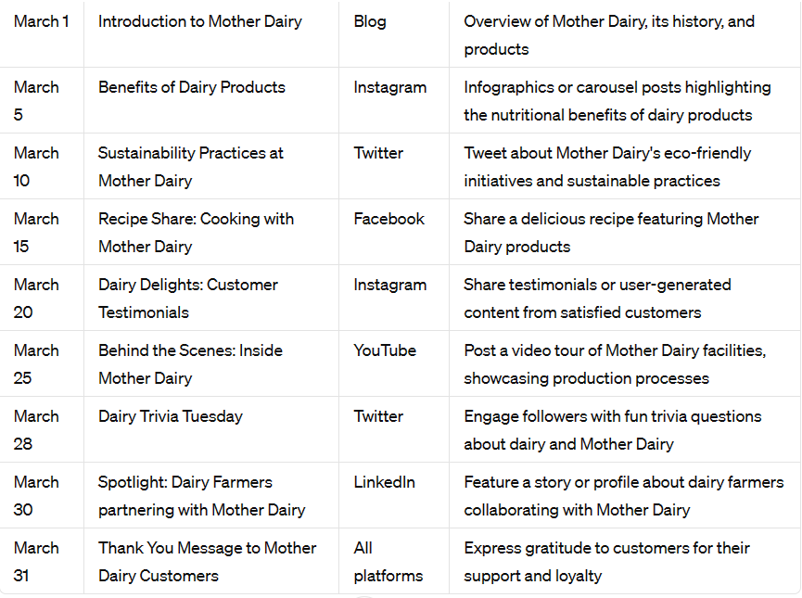
Strategy Aim and the Behind this Story

Slide 15
2.SEO & Keyword Research: 2.1 SEO AUDIT
● SEO Audit: Do an SEO audit of the brands website
● Keyword Research: Define Research Objectives, Brainstorm Seed Keywords,
Utilize Keyword Research Tools (SEMrush or Moz Keyword Explorer),Analyze
Competitor Keywords, Long-tail Keyword Exploration (specific, longer phrases) that
align with the research objectives and have lower competition but higher conversion
potential.
● On page Optimization: Meta Tag optimization & content optimization
Reflect on the process of conducting keyword research and the SEO recommendations
provided.
Document the challenges faced during the research and analysis phase, as well as the key
insights gained from the keyword research process.

Slide 16
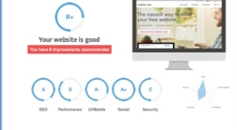
SEO AUDIT

Slide 17
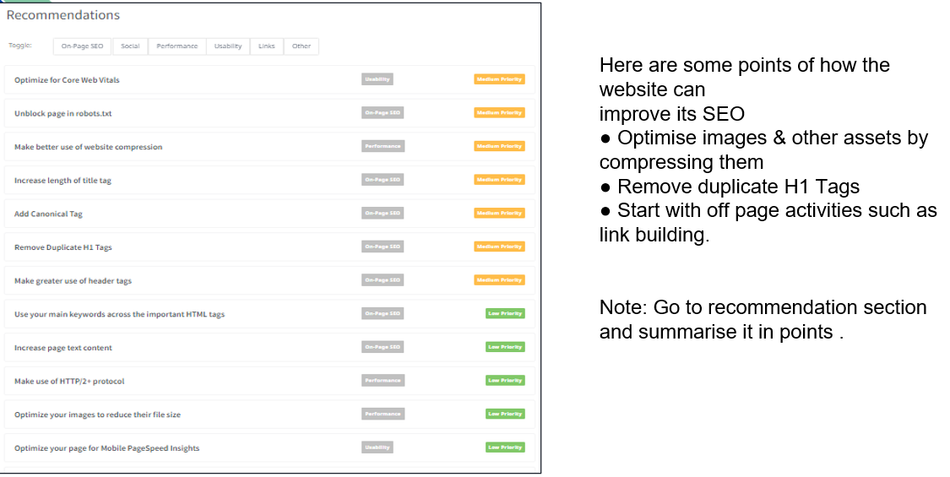

Slide 18
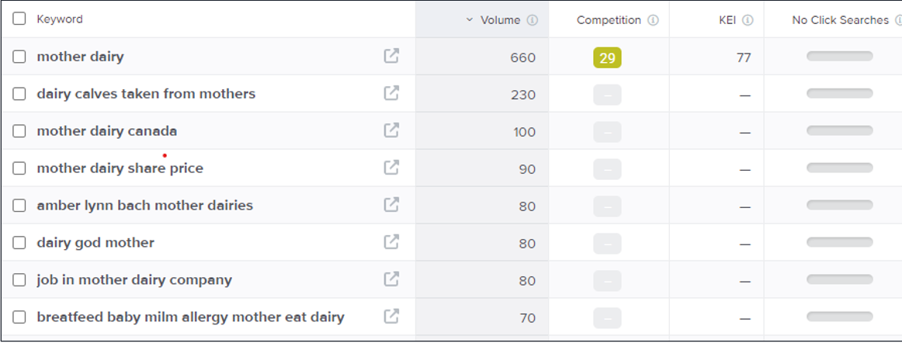
2.2 KEYWORD RESEARCH

Slide 19
2.3 ON PAGE OPTIMIZATION
Focus Keyword: Best milk for health and immune boosters,( vitamanB12)
Meta Title : Best milk for health :Mother dairy of Meta description:
(Vitaminb12)
Mother Dairy milk manufactures, markets and sell milk and milk products like curd,milk,paneer,butter....etc.,

Slide 20
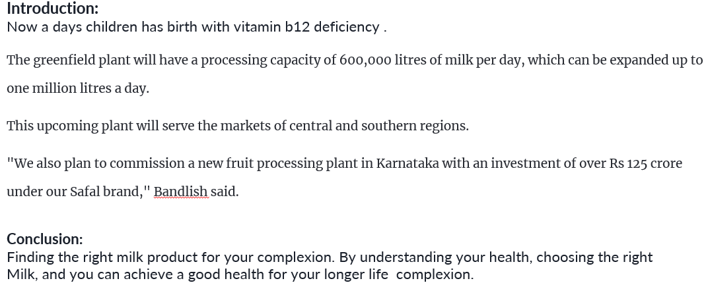
On Page Optimization(conmtent optimization)

Slide 21
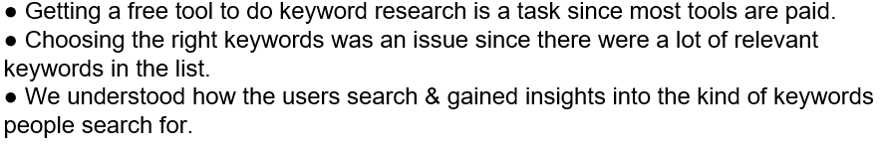
Document the challenges faced during the research and analysis phase, as well as the key insights gained from the keyword research process.

Slide 22
3.Content Ideas & Marketing Strategies: 3.1 CONTENT IDEA GENERATION & STRATEGY
Content Idea Generation & Strategy: Create a content calendar for the remaining month of July
by brainstorming content themes, exploring various formats like blog posts, videos, infographics,
podcasts, and interactive quizzes, and scheduling publication dates mainly on Facebook &
Instagram. And include the strategy, aim and the idea behind only for the post and story
mentioned in the calendar.

Slide 23
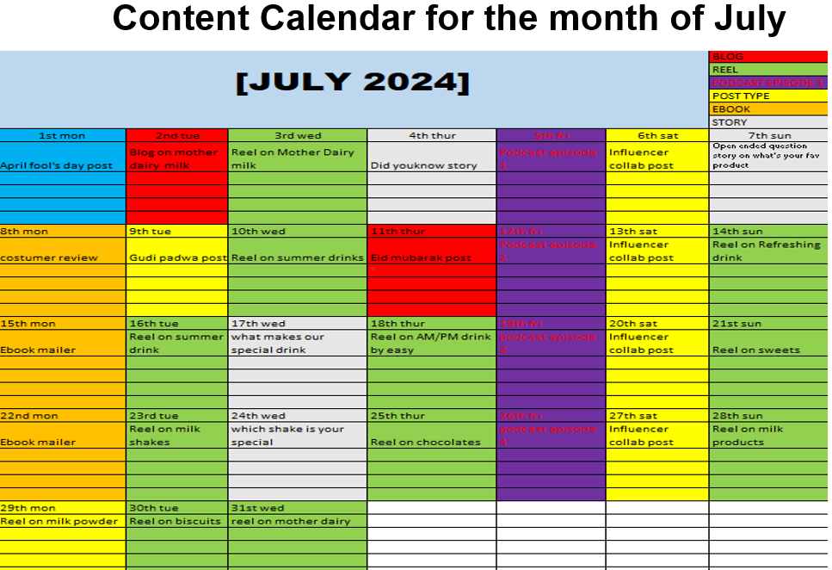

Slide 24
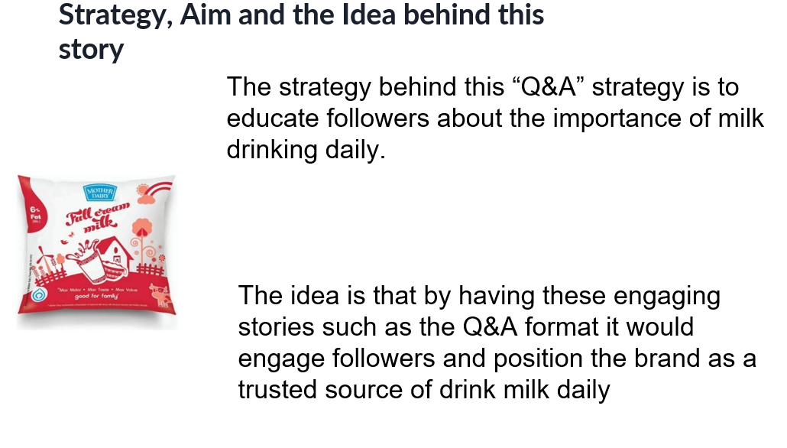

Slide 25
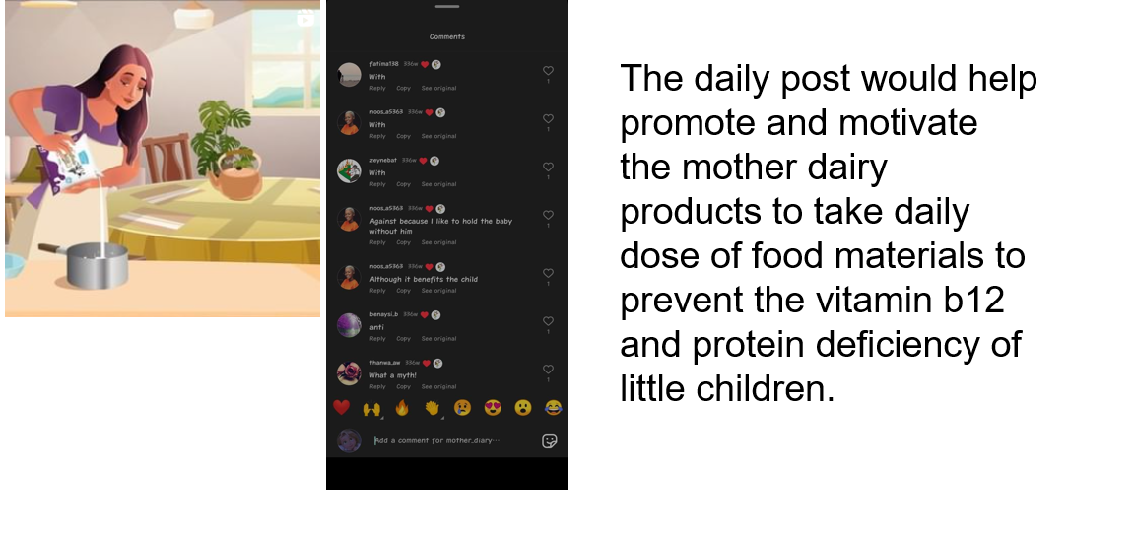

Slide 26
3.2 MARKETING STRATEGIES
Mother Dairy employs various marketing strategies to promote its brand and products effectively. Here are some key strategies:
1.Quality Assurance and Brand Reputation:
Mother Dairy prioritizes quality assurance and maintains a strong brand reputation for providing fresh, safe, and high-quality dairy products. This commitment to quality serves as a cornerstone of its marketing strategy and helps build trust with consumers.
2. Wide Product Range:
Mother Dairy offers a wide range of dairy products, including milk, yogurt, cheese, butter, ghee, ice cream, and more. Its diverse product portfolio allows the brand to cater to different consumer preferences and needs, thereby expanding its market reach.

Slide 27
4.Content Creation & Curation: 4.1 POST CREATION
Here are some ideas for engaging social media posts for Mother Dairy:
1.Product Spotlight:
Highlight a specific Mother Dairy product each week, showcasing its features, benefits, and versatility. For example, a post could feature Mother Dairy's freshly churned butter, emphasizing its creamy texture and delicious taste.
2. Recipe Inspiration:
Share mouthwatering recipes using Mother Dairy products as key ingredients. This could include recipes for homemade paneer tikka using Mother Dairy paneer or a refreshing mango lassi made with Mother Dairy yogurt.
3. Health and Wellness Tips:
Educate your audience about the health benefits of consuming dairy products. Share tips on incorporating dairy into a balanced diet, boosting calcium intake, or improving gut health with probiotic yogurt.

Slide 28
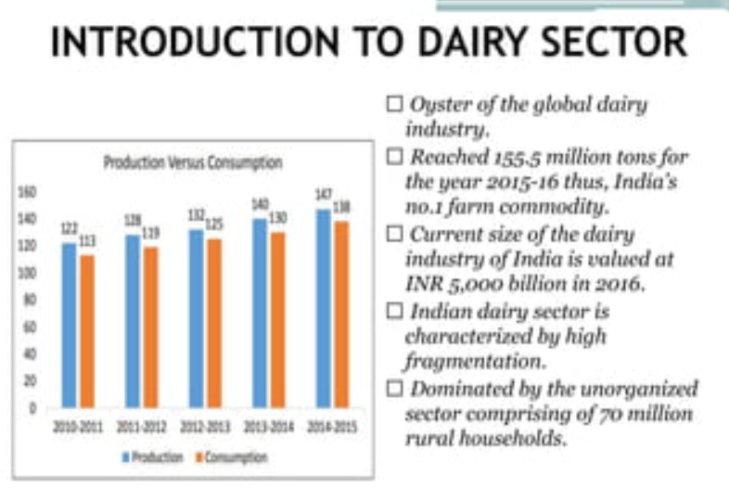

Slide 29
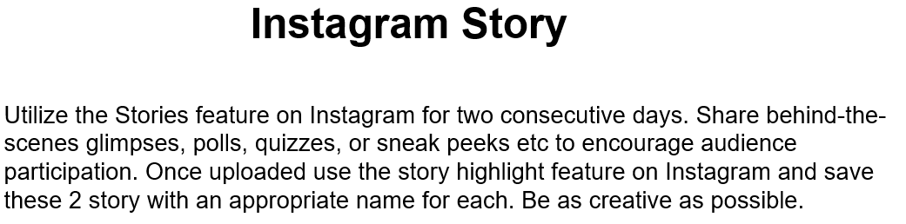

Slide 30
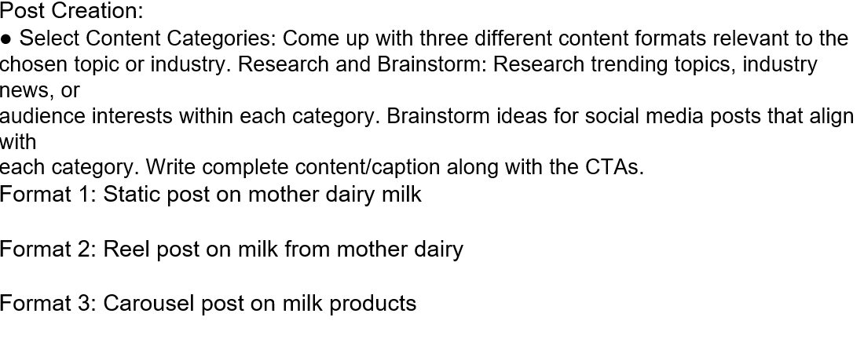

Slide 31
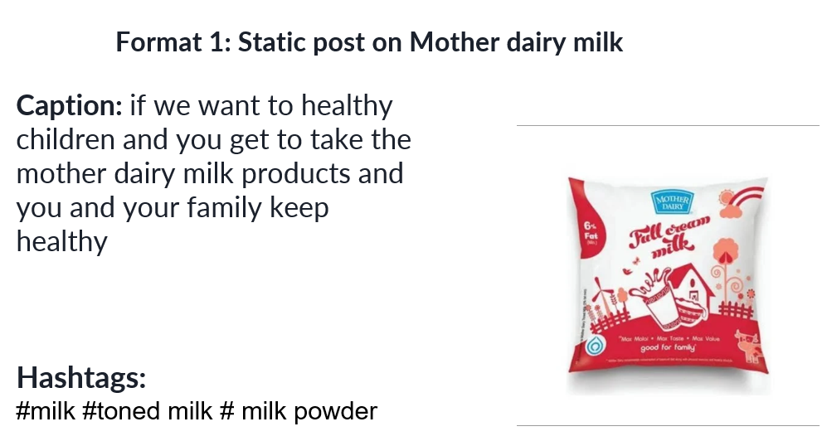

Slide 32
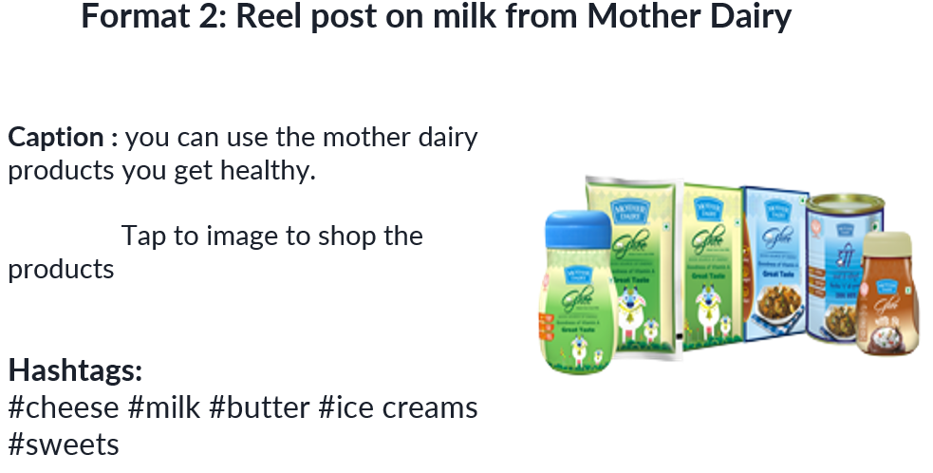

Slide 33
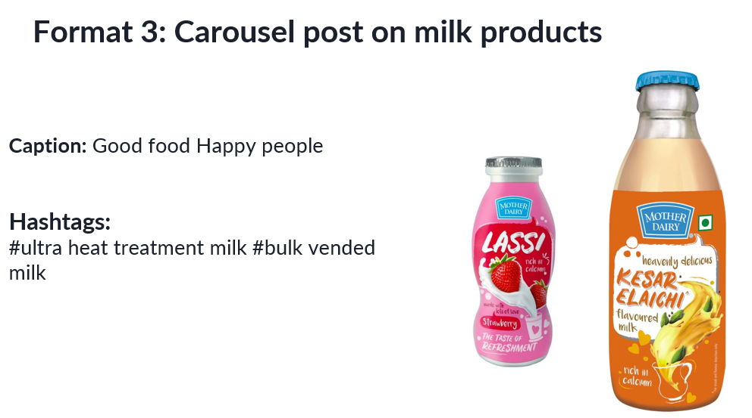

Slide 34

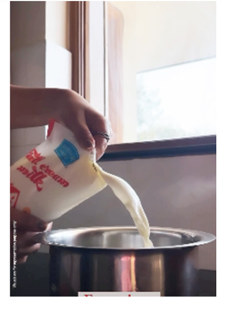
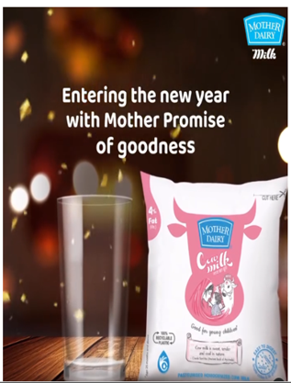
https://www.instagram.com/motherdairy48?igsh=ZW1kbWJ3eDNqNnFi

Slide 35
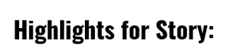
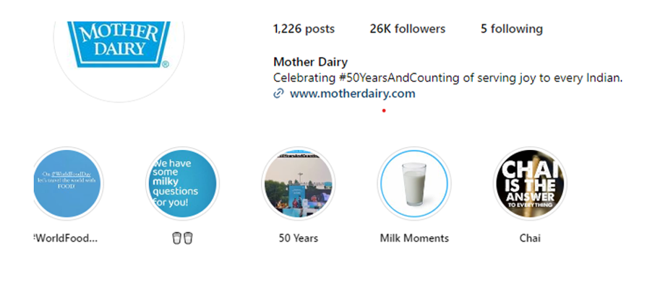
https://www.instagram.com/motherdairy48?igsh=ZW1kbWJ3eDNqNnFi

Slide 36
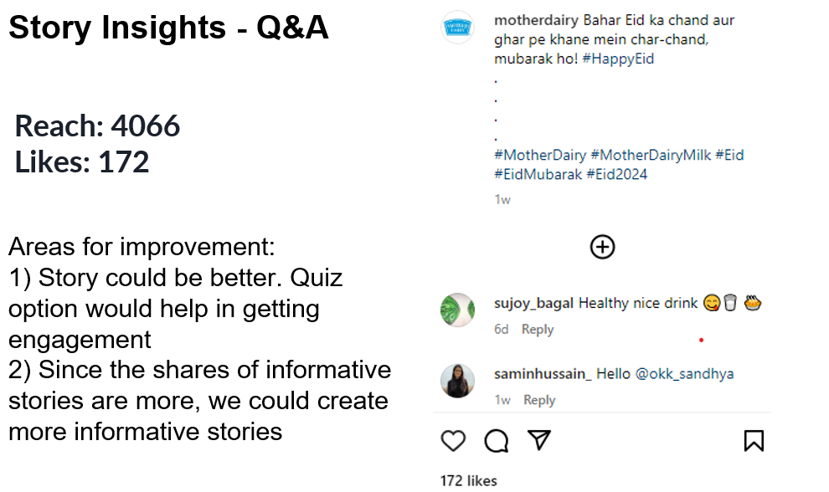

Slide 37
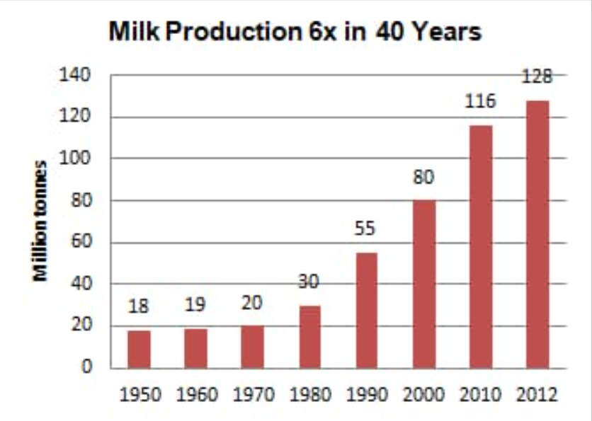

Slide 38
4.2 DESIGNS/VEDIO EDITING
Creating visually appealing designs and video editing for Mother Dairy can help enhance the brand's online presence and engage its audience effectively. Here are some ideas for designs and video editing techniques:
Design Ideas:
1.Product Showcase:
Create visually appealing graphics or images showcasing Mother Dairy's various dairy products, such as milk, yogurt, cheese, and ice cream. Highlight the freshness, quality, and nutritional benefits of each product.
2. Recipe Cards:
Design recipe cards featuring delicious dishes made with Mother Dairy products. Include step-by-step instructions, ingredients, and mouthwatering images to inspire your audience to try the recipes at home.

Slide 39
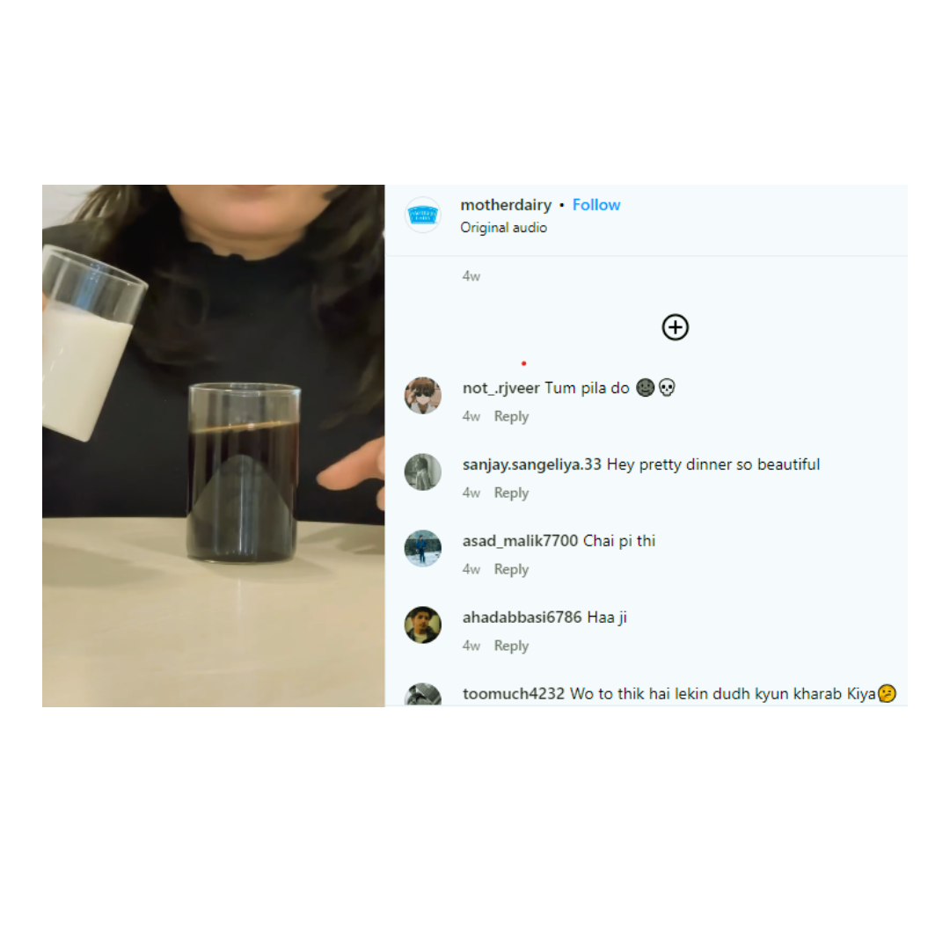
if you have uploaded a static image post like this. You can use https://www.canva.com/
to create a very simple and attractive post. Make sure to bring out the message of your brand selected.

Slide 40
Video Editing Techniques:
1.Product Demonstrations:
Produce short video clips demonstrating the use of Mother Dairy products in cooking or preparing delicious recipes. Showcase the versatility and convenience of Mother Dairy products in everyday meals.
2. Behind-the-Scenes Footage:
Capture behind-the-scenes footage of Mother Dairy's production facilities, farms, or quality control processes. Give viewers a glimpse into the journey from farm to table, highlighting the brand's commitment to freshness and quality.
3. Recipe Videos:
Create engaging recipe videos featuring step-by-step instructions for preparing mouthwatering dishes using Mother Dairy products. Use close-up shots, dynamic editing, and enticing visuals to make the recipes come to life on screen.

Slide 41
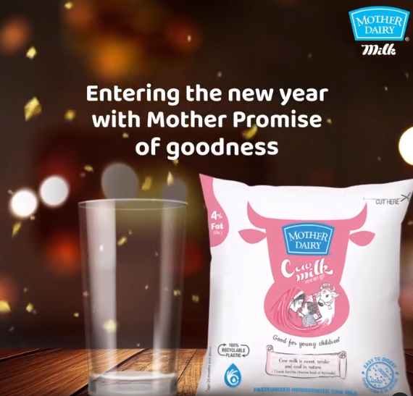
Similarly, when using video. Try to take the help of canva or VN app in creating the videos. You can use stock videos from
https://www.pexels.com/

Slide 42
4.3 SOCIALMEDIA AD CAMPAIGNS
Social media ad campaigns for Mother Dairy can help increase brand awareness, drive engagement, and boost sales. Here are some ideas for effective social media ad campaigns:
1.Product Spotlight Campaign:
Highlight a different Mother Dairy product each week with visually appealing ad creatives and compelling copy highlighting its features, benefits, and uses. Incorporate user-generated content or customer testimonials to add authenticity to the campaign.
2. Recipe Inspiration Campaign:
Showcase mouthwatering recipes using Mother Dairy products in carousel or video ad formats. Feature step-by-step instructions, vibrant images or videos, and enticing descriptions to inspire your audience to try the recipes themselves.
3. Seasonal Promotions Campaign:
Launch seasonal ad campaigns to coincide with holidays, festivals, or special occasions. Offer limited-time promotions, discounts, or bundle deals on Mother Dairy products, and use themed ad creatives to capture the festive spirit.

Slide 43
4.4 EMAIL AD CAMPAIGNS
Email ad campaigns for Mother Dairy can be an effective way to engage with customers, promote products, and drive sales. Here's a plan for an email ad campaign:
1.Segmentation:
Segment your email list based on factors such as purchase history, preferences, and demographics to ensure that your emails are relevant to each recipient.
2. Welcome Email Series:
Send a series of welcome emails to new subscribers introducing them to Mother Dairy, highlighting key products, and offering a special welcome discount or incentive to make their first purchase.
3. Product Promotions:
Highlight specific Mother Dairy products in your email campaigns, showcasing their features, benefits, and uses. Include visually appealing images, product descriptions, and links to purchase directly from your website.

Slide 44
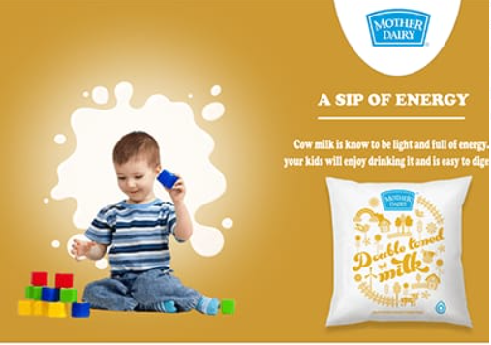
4. Recipe Inspiration:
Share delicious recipes using Mother Dairy products in your emails, providing step-by-step instructions, cooking tips, and serving suggestions. Encourage recipients to try the recipes themselves and share their creations on social media.
5. Seasonal Offers:
Run email campaigns to coincide with seasonal holidays, festivals, or special occasions, offering limited-time promotions, discounts, or seasonal product bundles. Create a sense of urgency by emphasizing the time-sensitive nature of the offers.

Slide 45


